Slide 1
KEN4256
Course Overview

Slide 2
Course Learning Objectives
Able to define and describe what a Knowledge Graph is
Able to identify and describe the components of a Knowledge Graph
Able to distinguish between different representations of Knowledge Graphs, and identify their strengths and weaknesses
Able to describe and execute approaches to construct Knowledge Graphs from structured and unstructured sources, across different domains
Able to construct and query Knowledge Graphs to answer questions about their content using open standards such as RDF and SPARQL
Use Large Language Models to construct knowledge graphs, and to retrieve their contents.

Slide 3
Learning objectives (cont.)
Able to execute link prediction and associated graph mining techniques to enrich information in Knowledge Graphs
Able to describe the FAIR principles and construct KG metadata using available standards
Able to describe KG quality metrics and evaluate the quality of a KG
Able to develop your own KG solution for a problem of interest

Slide 4
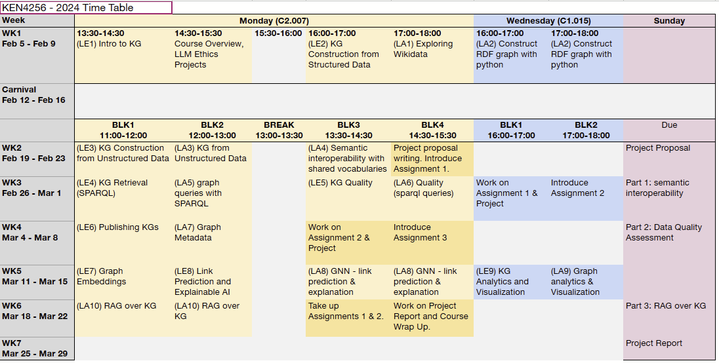

Slide 5
Course materials
Slides for the labs and lectures will be released on Canvas just before the respective session in PDF format. You can download and follow along during lectures and labs.
Assessments will also be released in PDF format on Canvas according to the dates indicated in the previous slide for evaluation.
Your solutions for the assignments and the project will also be uploaded on Canvas on the deadlines indicated on the previous slide. More instructions will be provided in the description documents for these assessments when they are released.

Slide 6
Project
Provides knowledge for
Please attend the lectures & labs!
Assignments
Provides knowledge for
Labs & lectures

Slide 7
Evaluation
3 Group assignments to build knowledge and core skills (45% of final grade; 15% each)
Assignment 1
Semantic interoperability over structured and unstructured data
Released February 19, due March 3 (23:59 CET)
Assignment 2
Data quality assessment with wrong data
Released February 26, due March 10 (23:59 CET)
Assignment 3
RAG over knowledge graph
Released March 11, due March 24 (23:59 CET)
1 Individual project to demonstrate your creativity and technical virtuosity (55% of final grade; 10% project proposal, 45% written project report)
Project description released February 12
2-page project plan: February 25 (23:59 CET); feedback within 1 week.
Final project report: March 31 (23:59 CET)
no final exam!

Slide 8
The AI/LLM space is moving fast...
We'll be using LLMs for KG construction, query answering (RAG), and potentially other uses.
Recommend using Open Source LLMs such as Mistral, LLAMA, etc. Check out the open source LLM leaderboard from hugging face. new LLMs make the top every week. https://huggingface.co/spaces/HuggingFaceH4/open_llm_leaderboard
Many tools for working with LLMs (CLI, RAG, others) include Ollama, Langchain, LLMware, LLamaIndex
Learn what the community is doing and get inspired for your project.
Ideally, you have a GPU powered laptop. Otherwise you may consider a Google colab (pay as you go & subscription plans)

Slide 9
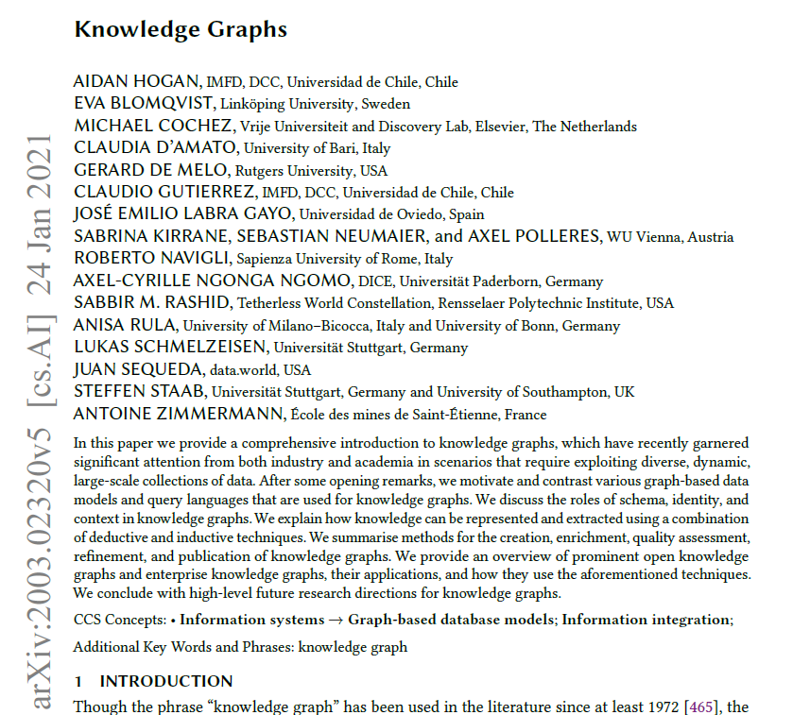
Recommended reading
https://arxiv.org/abs/2003.02320

Slide 10
Recommended reading
A Semantic Web Primer. 3rd Edition. Grigoris Antoniou, Paul Groth, Frank van Harmelen and Rinke Hoekstra. 2012. MIT Press, ISBN: 9780262018289.
Semantic Web for the Working Ontologist. 3rd Edition. James Hendler, Fabien Gandon, Dean Allemang. 2020. Morgan Kaufmann. ISBN-13: 978-1450376174; ISBN-10: 1450376177.
Practical RDF. Shelley Powers. 2003. O’Reilly Media, Inc. ISBN: 9780596002633
Learning SPARQL. Bob DuCharme. 2011. O’Reilly media, Inc. ISBN: 9781449306595
Programming the Semantic Web. Toby Segaran, Colin Evans, Jamie Taylor. 2009. O’Reilly Media, Inc. ISBN: 9780596153816

